Slide 1

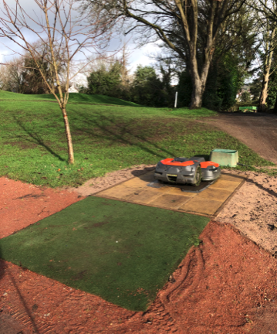
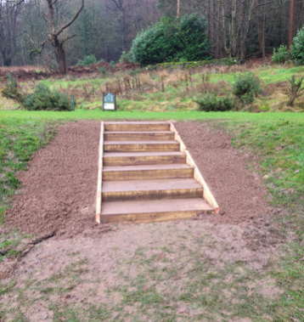
Greens Report
February 2026
After a very wet end to January unfortunately February has continued in the same vein.
However, on a positive note, our 3 robot mowers have been delivered. Our greens staff have been busy installing the charging stations out on the course.
They will be fully operational once our supplier, Balmers, have completed the base station installation and mapping of the course.
In addition, the course winter programme is in full swing. The lower branches on all trees throughout the playing areas have been removed.
New steps have been made and installed on the 5th tee and will be completed on the 12th tee soon.
All our remaining machinery have been serviced and repaired by our own greens team and replacement machines will arrive prior to the start of the golfing season.
Clearing of all existing ditches within the course playing area will commence once the ground is dry enough for a digger.
Russ Cranston
Greens Director

